Slide 1


GFIRE
Canopy Cover prediction
Summary
Francesco Tedesco
Pau Ventura
28/09/2023

Slide 2
General Overview
Data processing
Dades LiDAR
ML Model
FARSITE
Canopy Cover
prediction

Slide 3
Our data
BLOCK 2 km * 2 km
| x | y | z | c | a | n | r | i | t |
.laz
20 m * 20 m cells
CANOPY COVER
.tiff
SLOPE
.tiff
LAND USE
10 m * 10 m cells
.tiff
ASPECT
.tiff

Slide 4
Data processing: BLOCKS
collect_pixels_LeftTop()
FEATURE EXTRACTOR
statistics
quantils
thresholds
percentages
counting
…

Slide 5
Data processing: MERGE
GRONDTRUTH
BLOCK 2 km * 2 km
PROCESSED
SLOPE
ASEPCT

Slide 6
Training the model (XGBoost)
Feature selection
Remove the less significant
features iteratively
Hyperparameter search
Adjust XGBoost parameters
Cross validation
Final prediction
Train the model using all blocks
Get the final metrics

Slide 7
Cluster: lex/shared/projects/nnveget
scritps
data
results
ML_utils
control_test_laz
name: # blocks
id: # blocks
id: # blocks
id: # blocks
block_processing.py
laz
metrics
FE_class.py
model
reading_laz.py
tifs
vizz
GT_prediction.py

Slide 8
GFIRE
Canopy Cover Prediction
Update
Francesco Tedesco
Pau Ventura
28/09/2023

Slide 9
Feature Selection
20 m
Characterizing
20 m
152 Features
High Execution Time (24 blocks = 1h)
High memory usage
Redundancy
Model Overfitting
Less explainability

Slide 10
Feature Selection
Feature Selection
152 Features
20 Features
High Execution Time (24 blocks ~ 1h)
Redundancy
Model Overfitting
Less explainability
Low Execution Time (24 blocks ~ 2 min)
No Redundancy
No Overfitting
High explainability

Slide 11
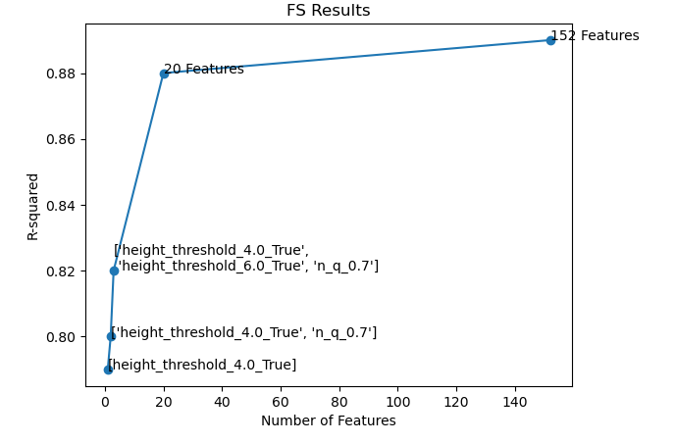
Feature Selection
20 Features:
'height_q_0.2', 'height_q_0.3', height_threshold_3.0_True', 'height_threshold_4.0_True', 'height_threshold_5.0_True', 'height_threshold_6.0_True', 'height_threshold_7.0_True',
'n_q_0.3', 'n_q_0.4', 'n_q_0.5', 'n_q_0.6', 'n_q_0.7', 'n_sd',
'i_threshold_10_True', 'i_threshold_130_False', 'i_threshold_70_False',
'num_points_5', 'num_points_2', 'r_threshold_1_False',
‘slope'

Slide 12
Full Model trained
8424 Blocks (all Catalunya)
4 h 30 min processing time
46 min Model Training
R2 Score: 0.89 (Train) ~ 0.88 (Test)
MAE Score: 6.30 (Train) ~ 6.47 (Test)

Slide 13
GFIRE
Canopy Cover Prediction
Control Blocks Prediction
Francesco Tedesco
Pau Ventura
28/09/2023
< 2 min execution

Slide 14
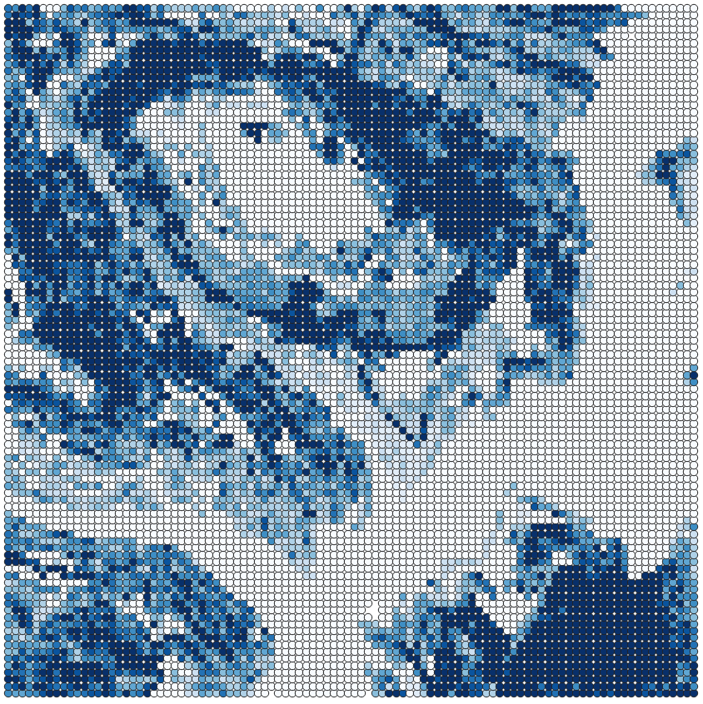
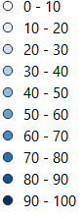
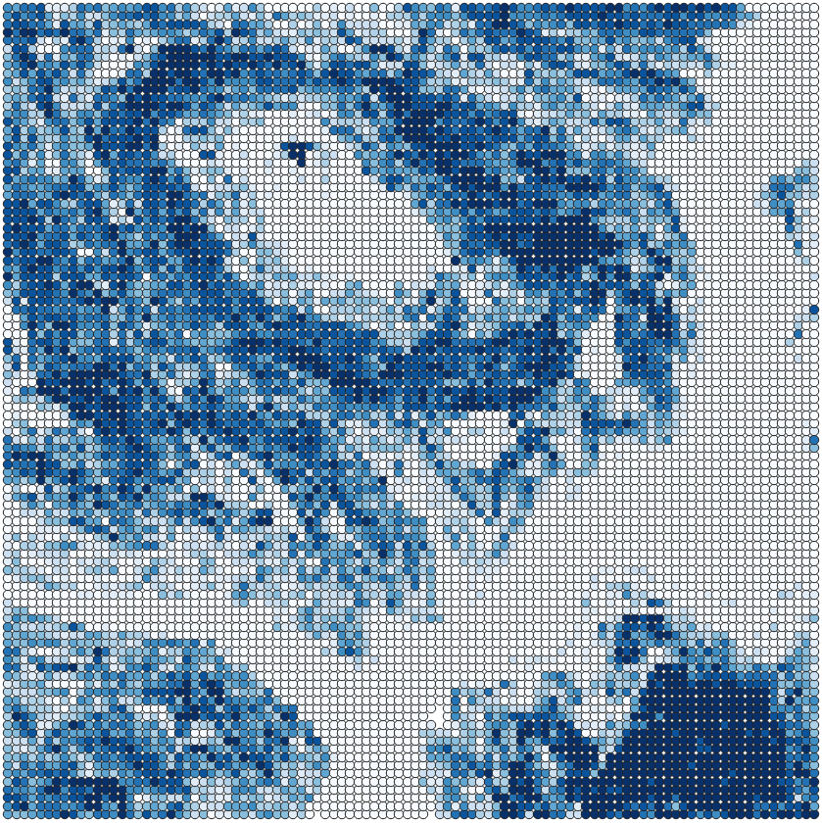
Model Predictions (representative data)
MAE:
11.1
Real
Predicted

Slide 15
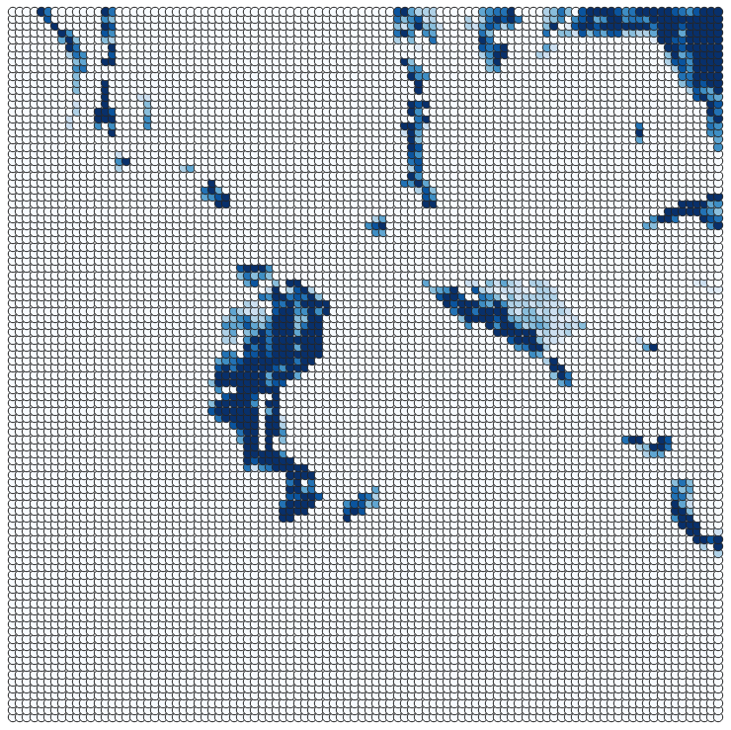
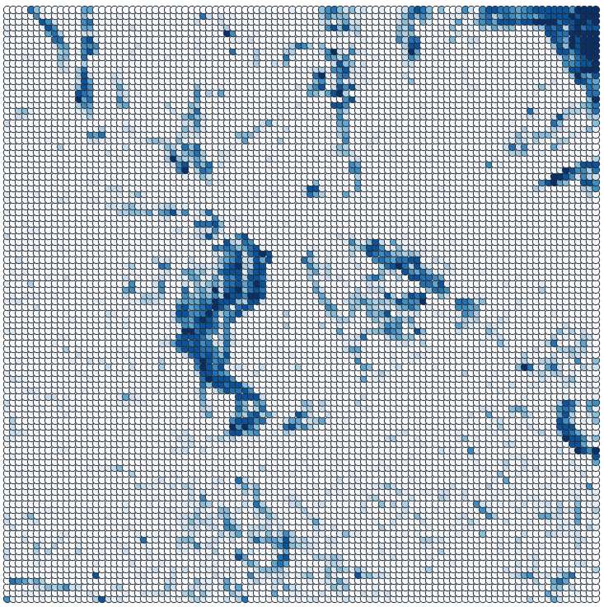
Model Predictions (representative data)
MAE:
7.8
Real
Predicted

Slide 16
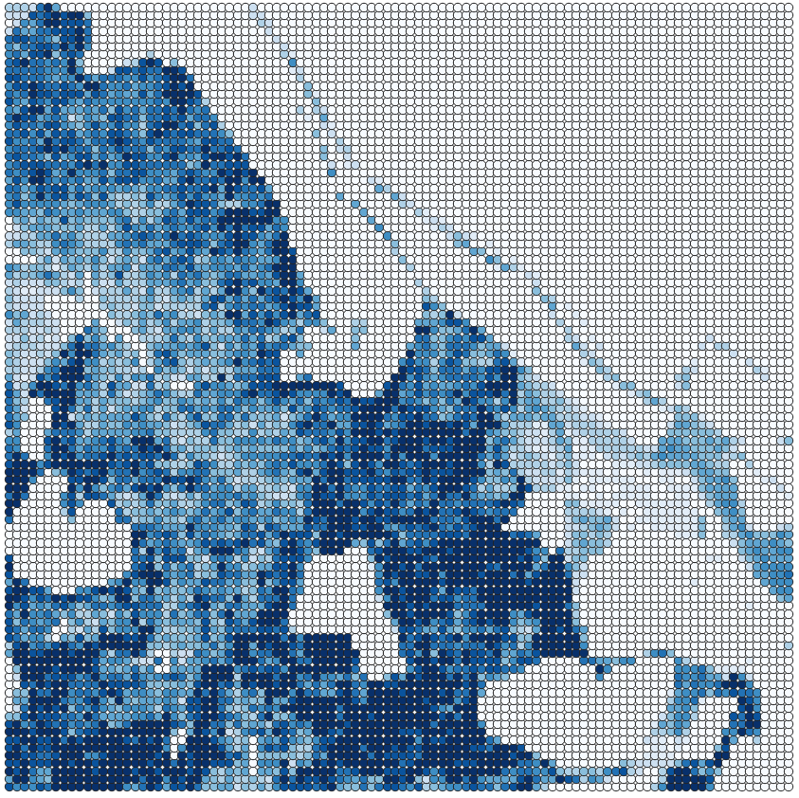
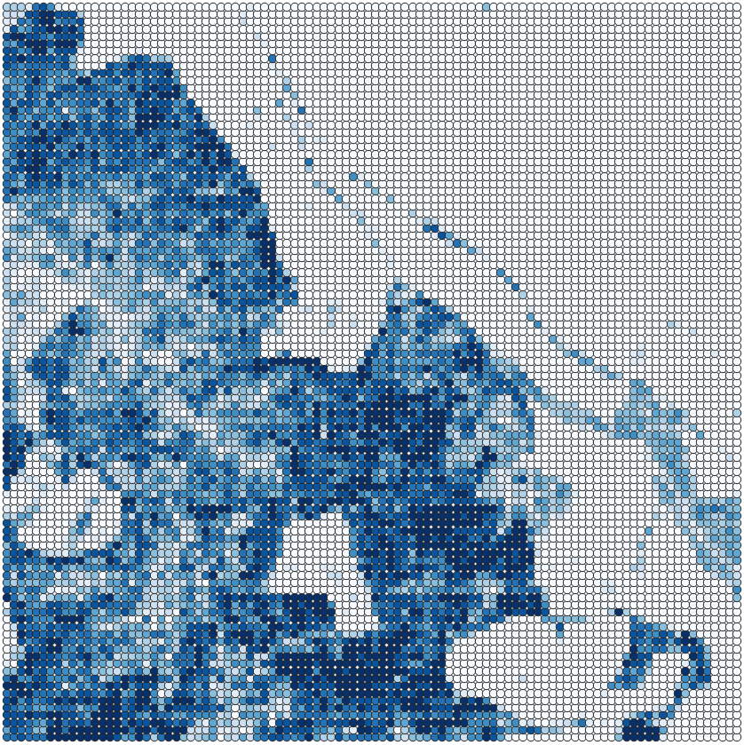
Model Predictions (representative data)
MAE:
6.0
Real
Predicted

Slide 17
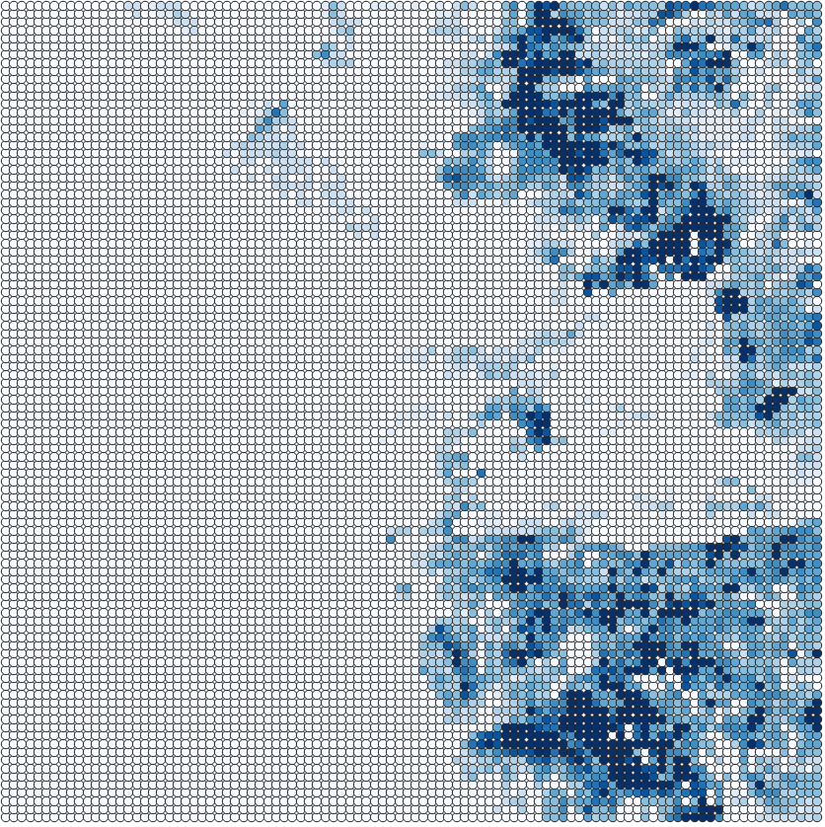
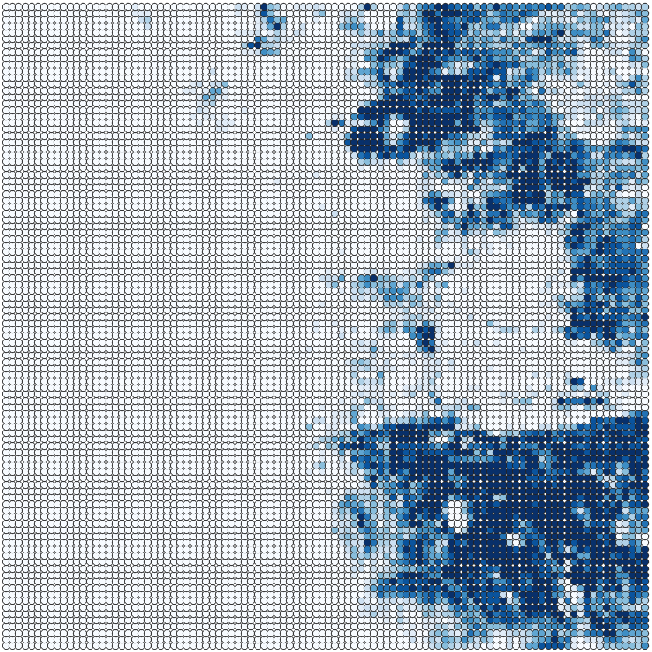
Model Predictions (representative data)
MAE:
8.8
Real
Predicted

Slide 18
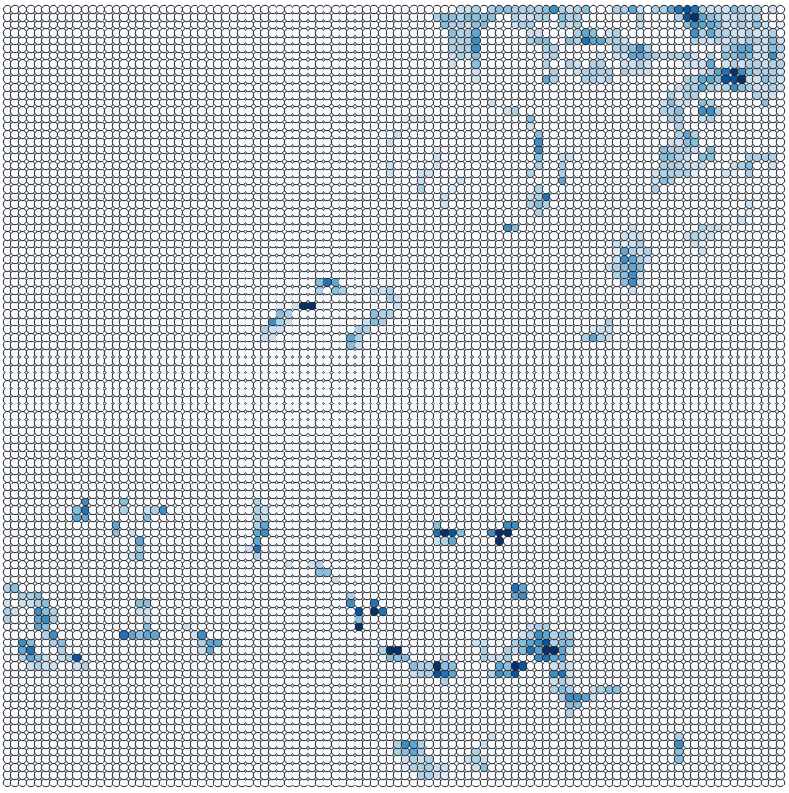
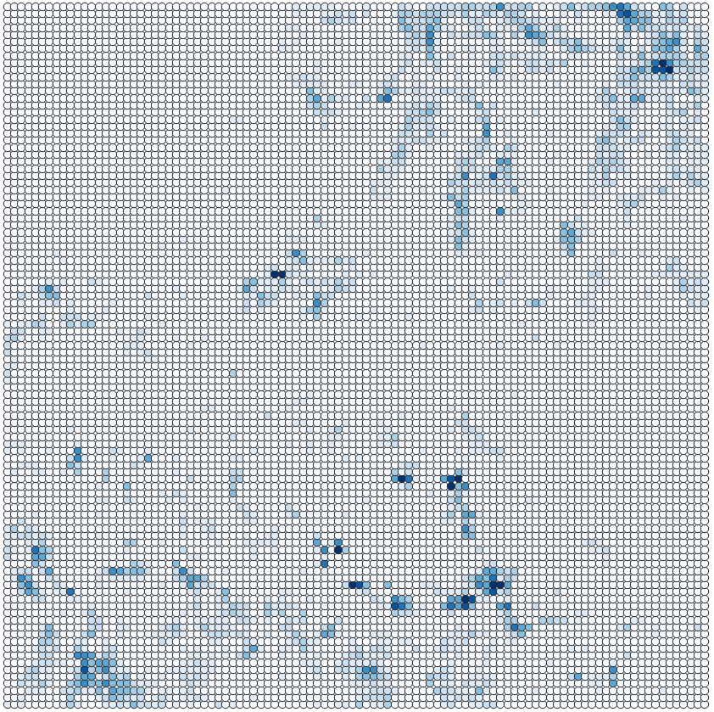
Model Predictions (representative data)
MAE:
4.5
Real
Predicted

Slide 19
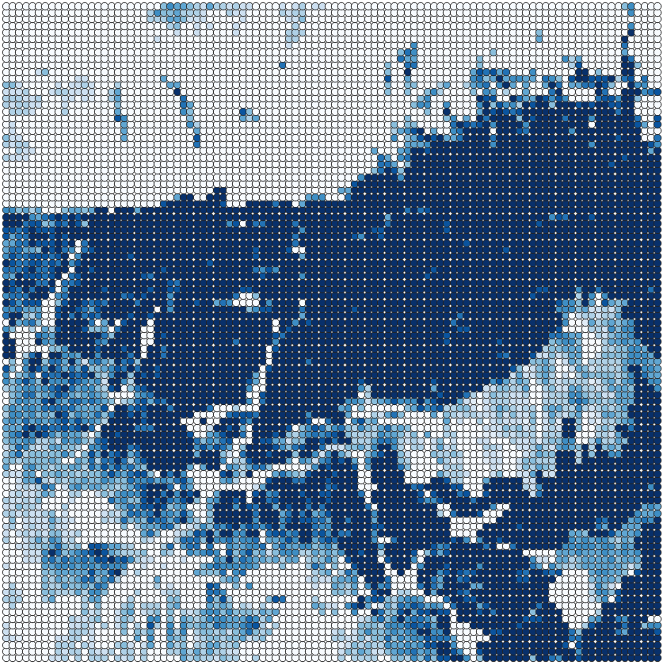
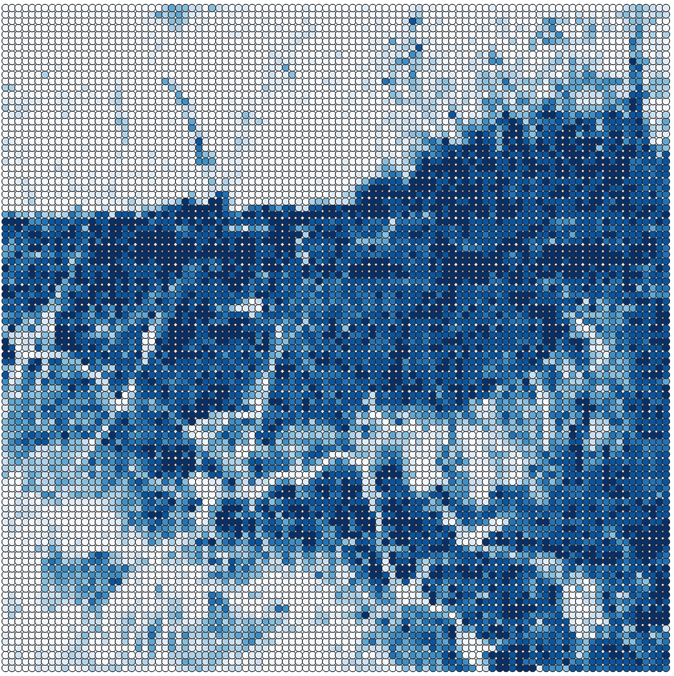
Model Predictions (representative data)
MAE:
12.6
Real
Predicted

Slide 20
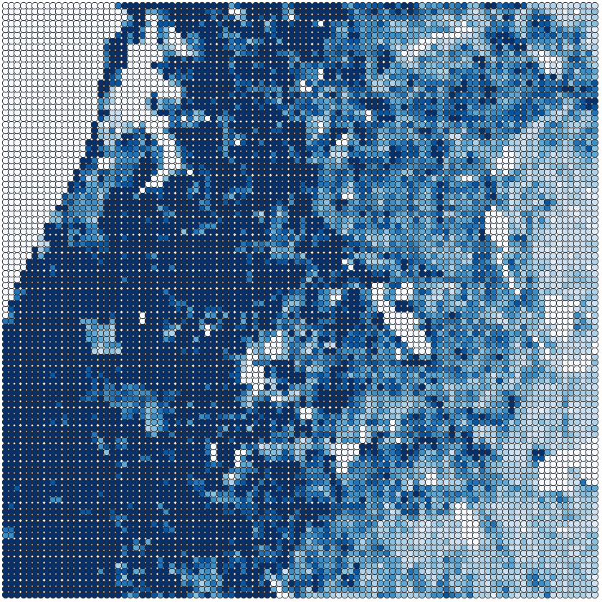
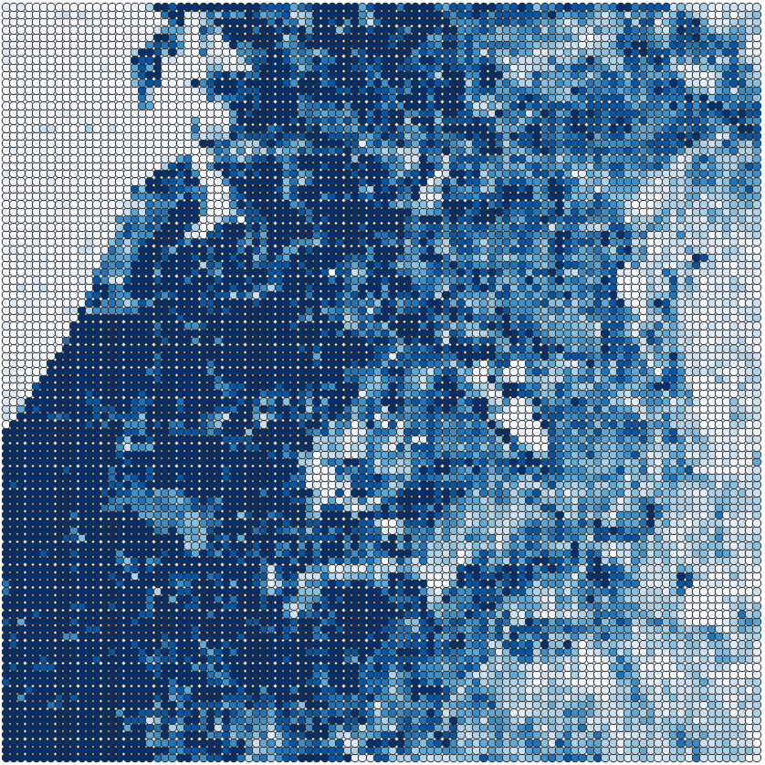
Model Predictions (representative data)
MAE:
7.7
Real
Predicted

Slide 21
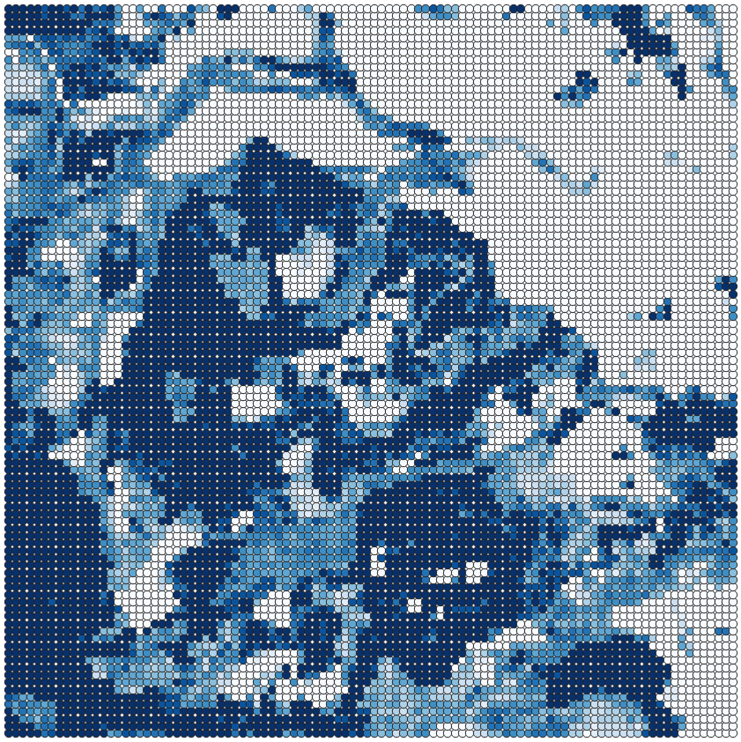
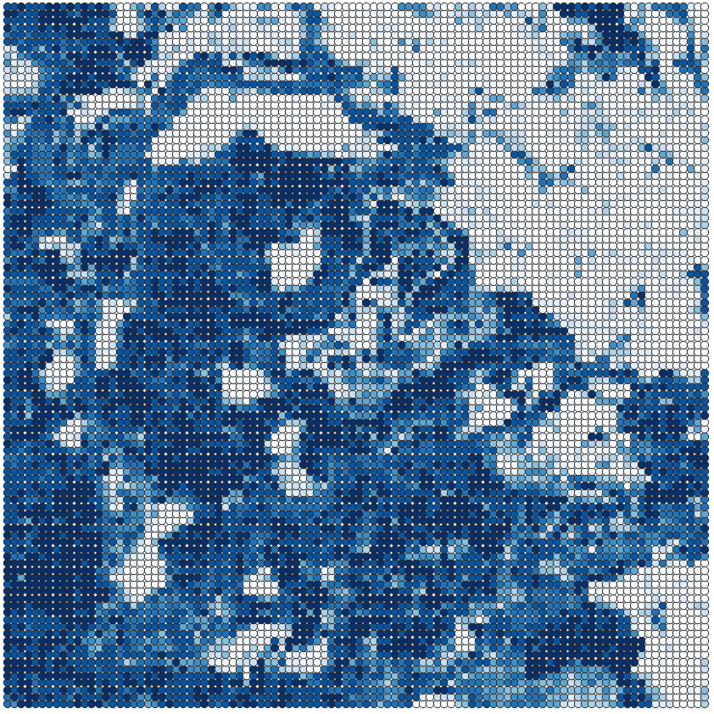
Model Predictions (representative data)
MAE:
13.9
Real
Predicted

Slide 22
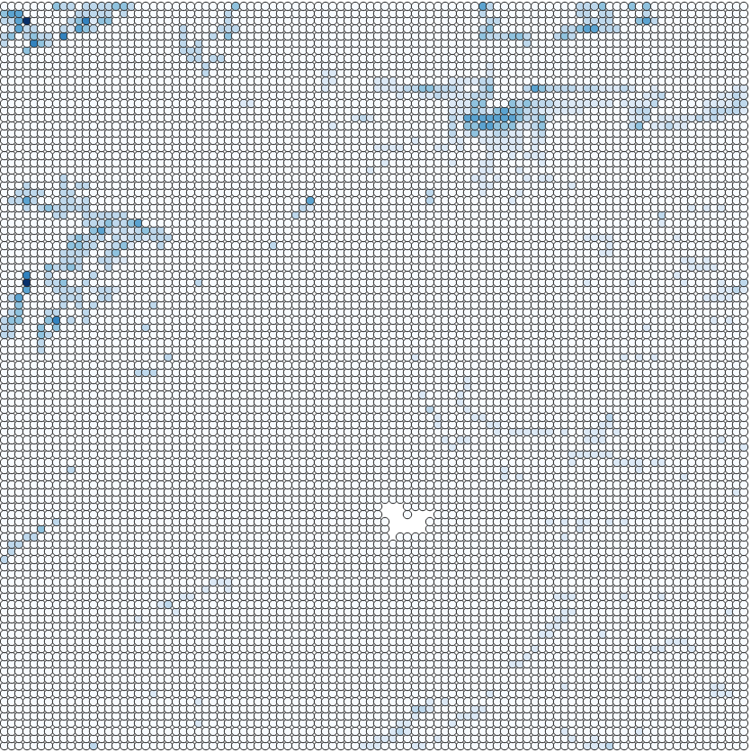
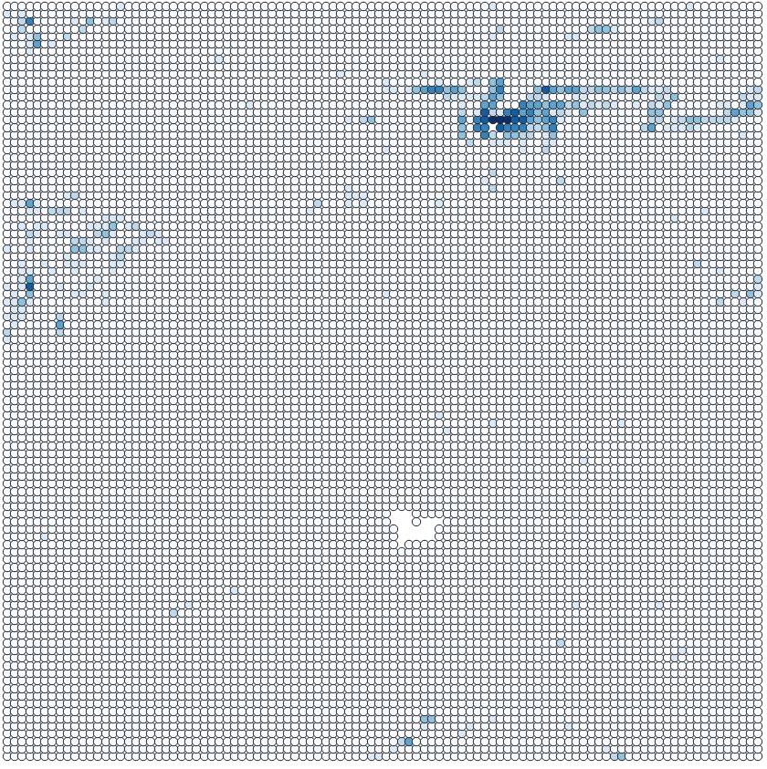
Model Predictions (representative data)
MAE:
1.11
Real
Predicted

Slide 23
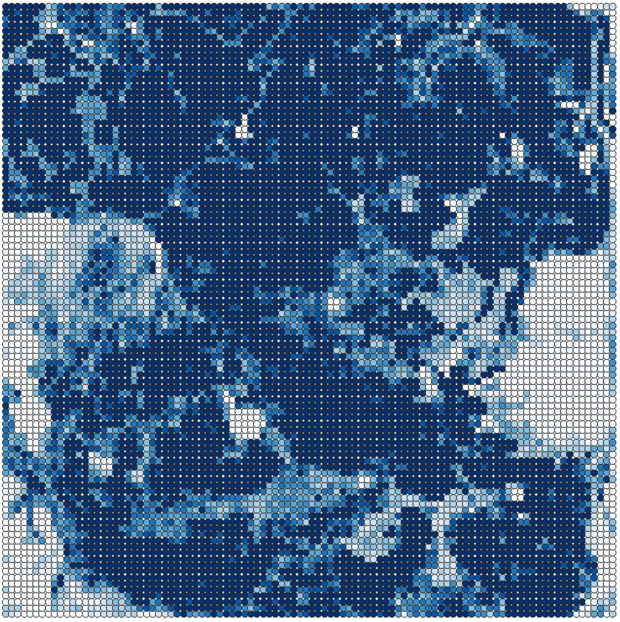
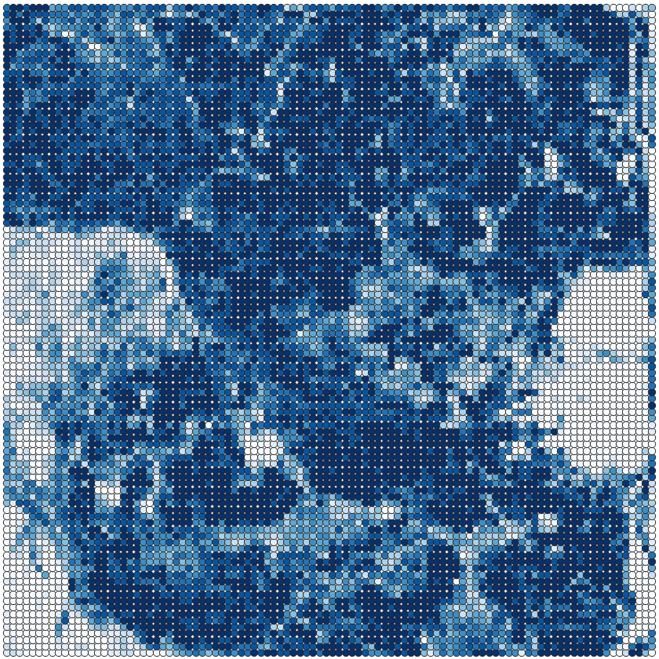
Model Predictions (representative data)
MAE:
10.0
Real
Predicted

